Slide 2
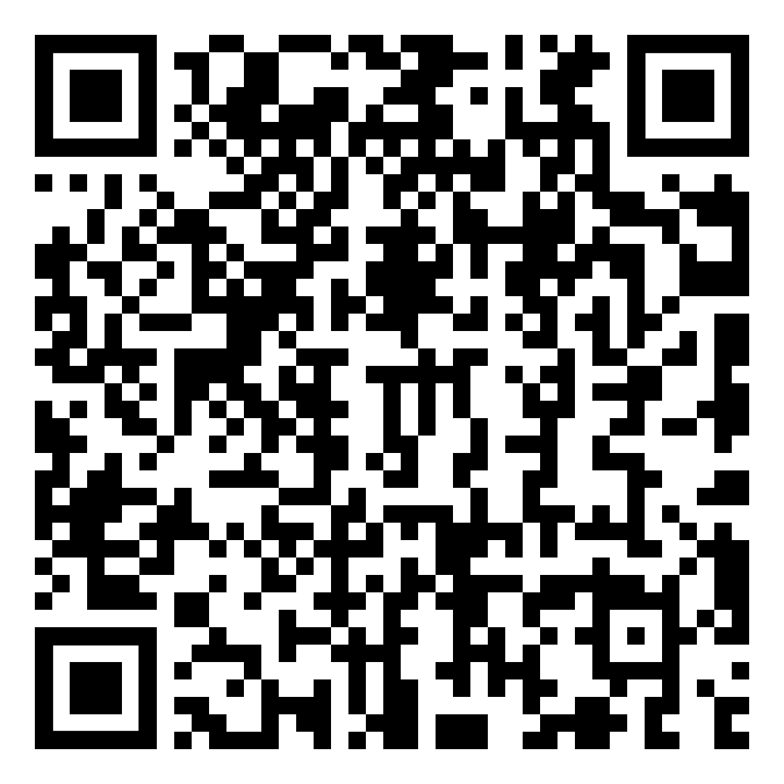

Code of Conduct
Remember the Golden Rule: Treat others as you would want to be treated - with kindness and respect
Scan the QR code to access and
review the CNCF Code of Conduct:

Slide 3

Virtual Audience Closed Captioning
Closed captioning for the virtual audience is available during each session through Wordly. The Wordly functionality can be found under the “Translation” tab on the session page.
Wordly will default to English. If another language is needed, simply click the dropdown at the bottom of the “Translation” tab and choose from one of 26+ languages available so you don’t miss a beat from our presenters.
*Note: Closed captioning is ONLY available during the scheduled live sessions and will not be available for the recordings on-demand within the virtual conference platform.

Slide 4
Session Q+A
Virtual attendees may submit questions to speakers through the CNCF Slack channel: #2-Kubecon-sessions
Please create a thread and tag the speaker(s) with questions about their talk.
Questions will be answered by the speaker and/or other community members after the session concludes.

Slide 5

Sponsor Shout-Out!
Thank you to our Session Recording Sponsor:

Slide 6
Enjoy the Session!

Slide 7
Introducing CloudEvents Discovery
Clemens Vasters, Microsoft
Klaus Deissner, SAP

Slide 8
What Happened so Far…
CloudEvents…
…specification was started in CNCF’s Serverless Working Group in (late) 2017
…project approved as sandbox-level project in May 2018
…specification v1.0 got released in October 2019, incubation-level
Meeting of the Serverless Working Group At KubeCon CloudNativeCon 2019 in San Diego
Decision to work on event discovery and subscriptions next
Since then
A lot of improvements and additional protocol bindings for the spec (today v1.02)
SDK work
Draft specs: CE SQL, Registry, Pagination and Subscriptions

Slide 9

What is Discovery?
What events are used in a specific context?
Event definition registry
What do they look like?
Schema registry
Where can I consume or produce them?
Endpoint registry

Slide 10
Event definitions
Groups of event definitions
Other message formats possible:
AMQP
MQTT
Protobuf
HTTP
…
definitionGroup
*
definition
{
"id": "Contoso.CRM.Events.CustomerNoteAdded",
"description": "A note has been added to a customer",
"format": "CloudEvents/1.0",
"metadata": {
"attributes": {…}
},
"schemaurl":"#/schemaGroups/Contoso.CRM.Events/schemas/customerNoteAddedEventData"
}

Slide 11
Describing CloudEvent attributes
"attributes": {
"id": {
"type": "string",
"required": true
},
"type": {
"type": "string",
"value": "Contoso.CRM.Events.CustomerNoteAdded",
"required": true
},
"source": {
"type": "uritemplate",
"value": "/crm/customers/{region}",
"required": true
},
"subject" : {
"type":"uritemplate",
"value": "urn:uuid:{customer}",
"description":"Customer ID",
"required":true
}
}
Additional constraints for context attributes
Mark attributes as required
Provide a more accurate type like uri or uritemplate

Slide 12
Schema registry
Collect schema information for payloads in groups
Store multiple versions of a schema
Schema definitions are widely used beyond messages and events
Independent from a specific schema definition language
schemaGroup
*
schema
*
version

Slide 13
Endpoints
Superset of definitionGroup
Additional attributes
usage: producer | consumer | subscriber
channel: Correlate multiple endpoints of the same channel
definitionGroups: References to existing definition groups
config: Connectivity configuration
endpoint
*
definition
"Contoso.CRM.Eventing.Http": {
"id": "Contoso.CRM.Eventing.Http",
"usage": "producer",
"config": {
"protocol": "HTTP",
"strict": false,
"endpoints": [
"https://erpsystem.com/events"
]
},
"channel":”my/topic",
"definitionGroups": [
"#/definitionGroups/Contoso.CRM.Events"
],
"format": "CloudEvents/1.0"
}
*
definitionGroup
(reference)

Slide 14
Producer and consumer endpoints
Consumer Endpoint
Producer Endpoint
Producer
Consumer
Producer
Consumer
Initiate Connection
Initiate Connection
Event consumers consume events from these endpoints
Sometimes referred to as Pull Model
Examples
Message consumption using MQTT or AMQP
Polling using HTTP (GET)
Event producers send events to these endpoints
Sometimes referred to as Push Model
Examples
Message publishing to an MQTT or AMQP topic
Posting events to an HTTP web hook

Slide 15
Subscriber endpoints
Subscriber Endpoint
Producer
Consumer
A subscription endpoint exposes a subscription API (https://github.com/cloudevents/spec/blob/main/subscriptions/spec.md)
A subscription defines a set of events that shall be sent to a specified producer endpoint

Slide 16
Channels
Channel
"usage": "producer",
"channel":”my/channel",
"usage": ”consumer",
"channel":”my/channel",

Slide 17
What do these have in common?
definitionGroup
endpoint
schemaGroup
*
definition
*
definition
*
schema
definitionGroup
(reference)
*
version
*

Slide 18
A Registry for Groups of Resources
API Access
GROUP
/model # Manage the registry model
/ # Show all Groups
/GROUPs # Manage a Group Type
/GROUPs/gID # Manage a Group
/GROUPs/gID/RESOURCEs # Manage a Resource Type
/GROUPs/gID/RESOURCEs/rID # Manage the latest Resource version
/GROUPs/gID/RESOURCEs/rID?meta # Metadata about the latest Resource version
/GROUPs/gID/RESOURCEs/rID/versions # Show version strings for a Resource
/GROUPs/gID/RESOURCEs/rID/versions/vID # Manage a Resource version
/GROUPs/gID/RESOURCEs/rID/versions/vID?meta # Metadata about a version
*
RESOURCE

Slide 19
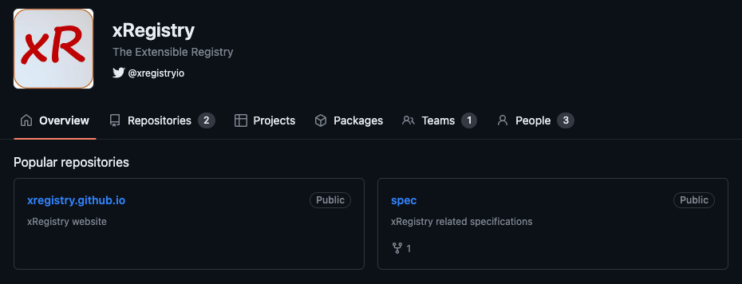
The New Repo on the Block

Slide 20

Start Small…
All in one .cereg file
Managed with your source code
Inline everything
Schema inside event definition
Event definition inside endpoint
With infrastructure support
Just schemas and event definitions
Let infrastructure create endpoint definition

Slide 21

…Or Do Something More Advanced
Host a central registry in your organization
Define events and schemas for re-use
Governance
Versioning
Interoperability with other organizations
Departments inside one company
Vendors
Customers
Federated discovery

Slide 22
Where We Are
Disclaimer
Everything is work in progress
Changes may and will happen
Opportunity: More people bring more …
… use cases
… perspectives
Challenges
Define CloudEvents for xRegistry
Enrichment or overloading for event definitions?
Endpoints that generically enrich events (example: partitionkey)
Validate concepts proof-of-concept implementations

Slide 23
Questions?

Slide 24
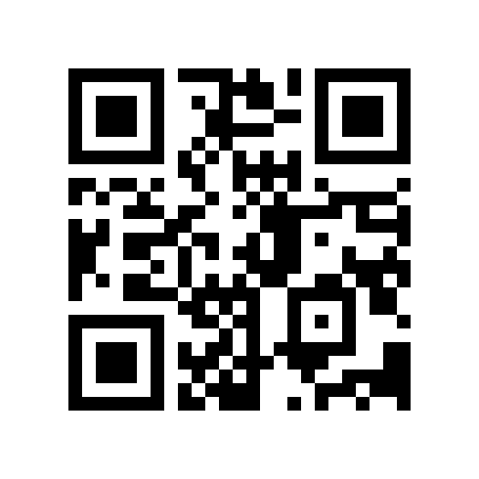
Please provide your feedback

